Slide 1


AI For ALL

Slide 2







IT Professional
AI, Data Analytics, & Blockchain Trainer
Marathon, Triathlon & Duathlon Athelete

Slide 3






Slide 4
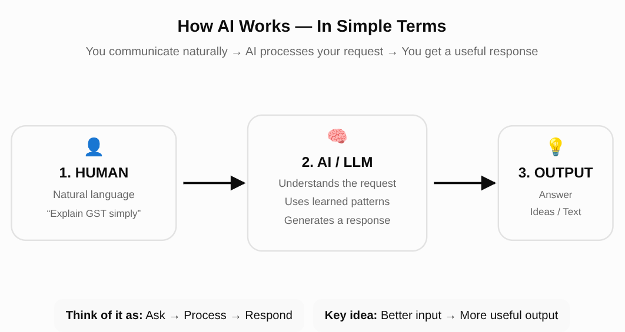

Slide 5
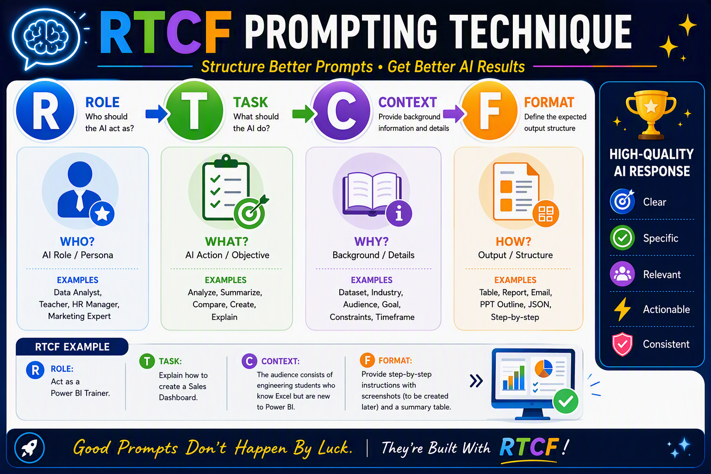

Slide 6
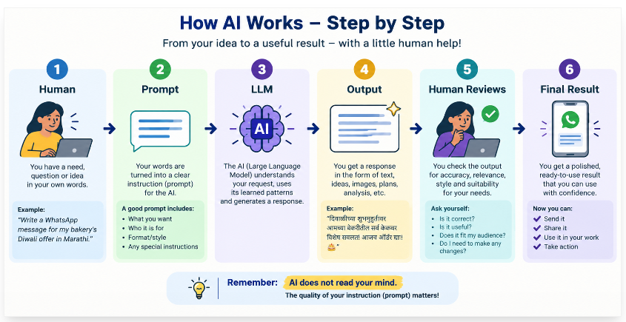

Slide 7

Demo

Slide 8
Ethics

Slide 9
Hallucination
Verify anything with real-world consequences — money, health, legal, exam dates — with a human or an official source.
Privacy
Never paste Aadhaar numbers, bank details, patient records, or sensitive information into any AI tool.
Assume anything typed into a free tool may be used to improve the product — treat it like a public notice board, not a locked diary.

Slide 10
Bias
AI learns from existing text and images, which carry existing human biases — so it can reflect stereotypes about gender, caste, or region.
Treat its output as a draft to review, not a verdict.
When to never use AI
Legal decisions — consult a lawyer
Medical diagnosis — consult a doctor; use AI only to prepare questions for that doctor.

Slide 11
Q & A

